Slide 1


Mastering Problem-Solving Techniques
A Comprehensive Guide to Tackling Algorithmic Challenges Efficiently

Slide 2




Table of content
01
The Egg Problem Breakdown
02
What is an Ad Hoc
03
How to solve a cp problem
04
Gravity flip problem
05
Corner Cases
06
Aunt Mahbouba (Easy Version)
07
Uncle Shita ( Hard Version)
08
Lets think together

Slide 3

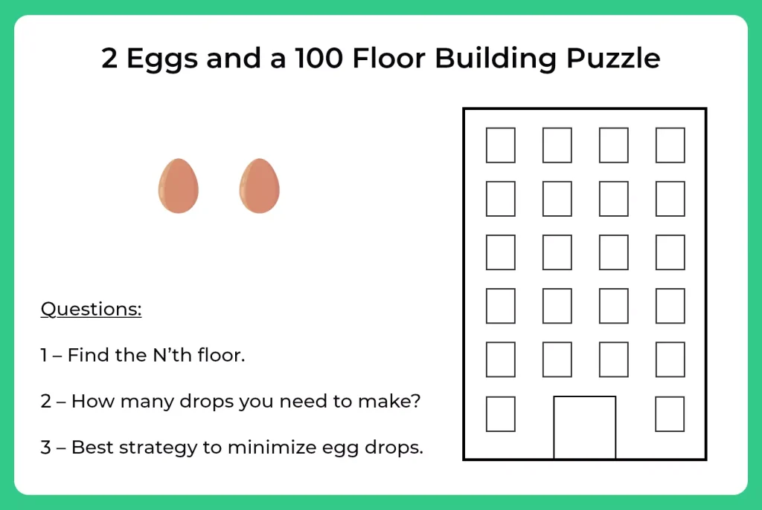
(worst case scenario)

Slide 4
What is an Ad Hoc ?
Ad hoc problems are those whose algorithms do not fall into standard categories with well-studied solutions. Each ad hoc problem is different; no specific or general techniques exist to solve them.

Slide 5
How to solve them
-read problem statement and filter information
-read constraints
-read tests cases and manually test them if it needs to for better understanding
-generate your own testcases and try to find a pattern
-divide and conquer

Slide 6
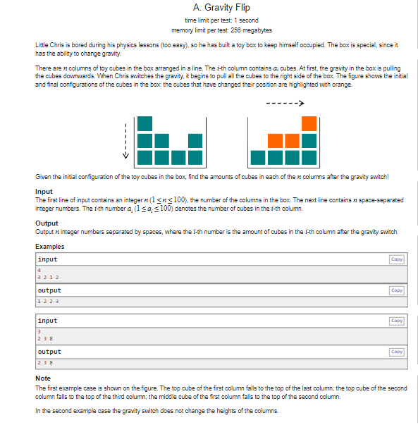
Gravity Flip Problem
Photo by Pexels

Slide 7
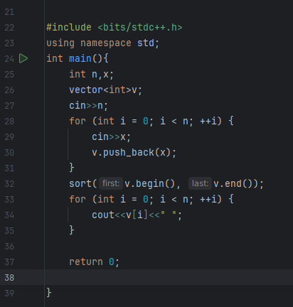
Photo by Pexels

Slide 8
Corner cases
Photo by Pexels

Slide 9
small problem :
Can you find the number of divisors for given integer x ?

Slide 10
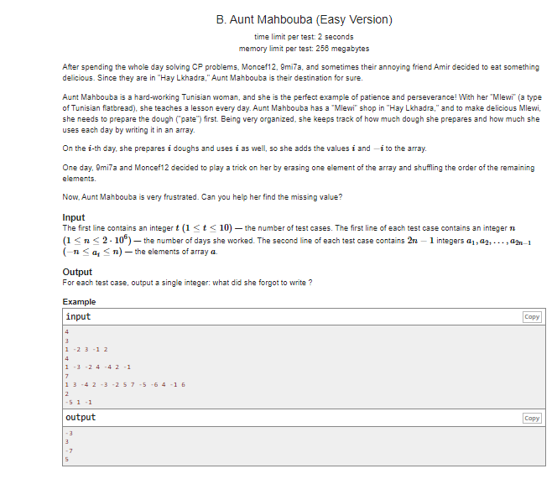

Slide 11
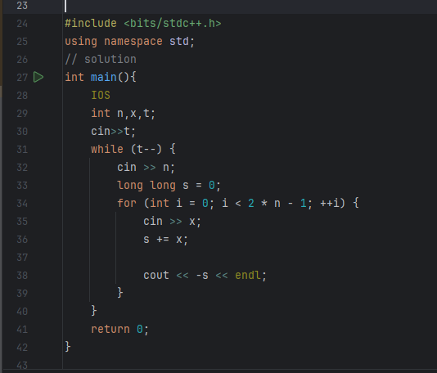

Slide 12
Uncle Shita (Hard version)

Slide 13
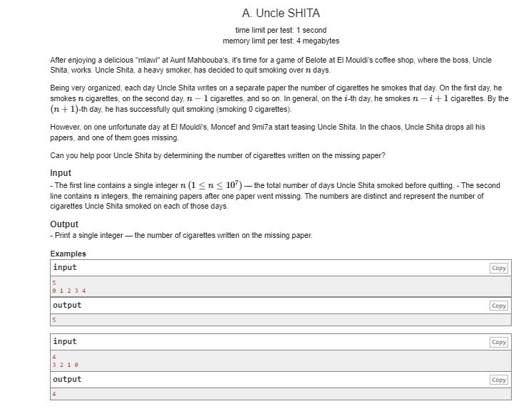

Slide 14
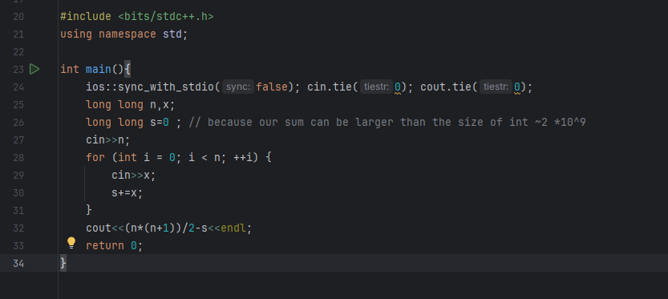

Slide 15
Lets think together

Slide 16
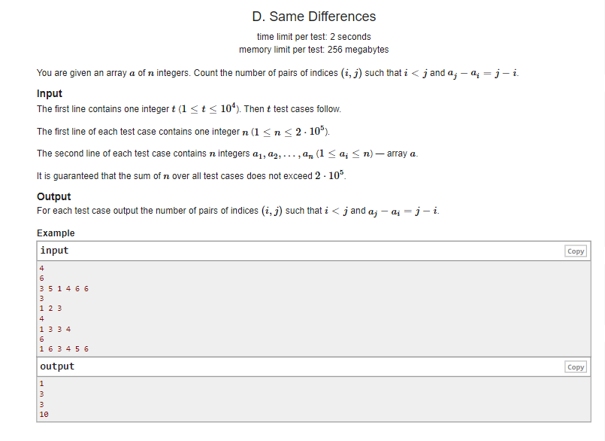

Slide 17
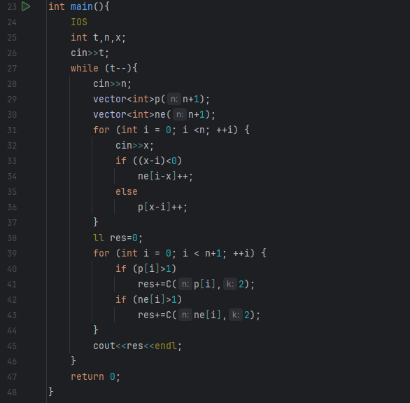

Slide 18
